Slide 1
Beyer Research Focus
Internet of Things
Bluetooth Low Energy security
Device vulnerability analysis
Security tool development
Smart home automation security assessment
Privacy Leakage
Vulnerability analysis
Pattern-of-life models

Slide 2
Smart Home
Host Machine
CITIoT: Classificaion, Identification, and Tracking of Internet of Things

Slide 3
Voice Commands
via Siri
iCloud
iPhone 6+
Apple TV
HomeKit
HomeKit
<<BLE>>
Device Specific Apps
<<BLE>>
<<BLE>>
<<WiFi>>
<<WiFi>>
BLE Devices
(b₁ - b₆)
Raspberry Pi
Homebridge
-WeMo Plugin
BLE Devices
(b₇ - b₁₁)
<<WiFi>>
User in Smart Home
WiFi Devices
(w₂ - w₉)
User away from Smart Home

Slide 4
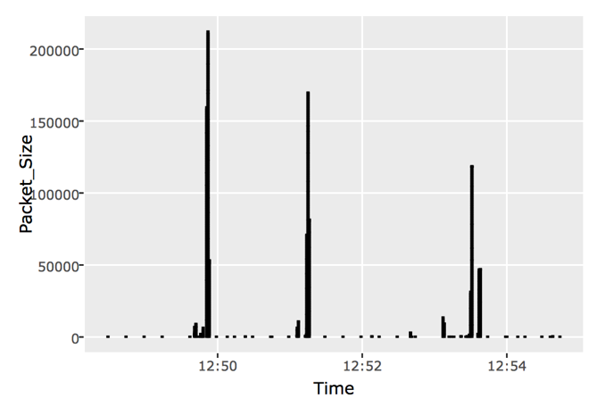
Homebridge
Logs
.csv
IoTCIT
Passive
Sniffing
Device Classification,
Event ID,
User Tracking
Import,
Visualize data
BLE Devices
Plots
.pcap
.csv
WiFi Devices
Test Matrix
Logs
.csv

